Slide 1


Free and Open Source Software Licenses
Introducere în universul licențelor FOSS
Prezentat în cadrul
Seminariilor geospatial.org
„Soluţii libere open source pentru prelucrarea și
reprezentarea datelor geospaţiale”
20-21 Octombrie 2017 de Lavinia Oanea

Slide 2
?
FSF
OSI
Open Source
Licență
Copyright
Copyleft
Obligații
Libertăți
Licență globală
Incompatibilitate
Licență duală
Fossolgy
BlackDuck
Palamida
GPL
Apache
BSD
Proprietate intelectuală
Licență permisivă
SPDX
Public Domain
Referință de licență

Slide 3
1. Introducere
FSF
Proiectul GNU
OSI
OSgeo

Slide 4


FSF
Free Software Foundation
Conceptul de software liber, ca filosofie de dezvoltare a aplicaţiilor, a fost puternic popularizat de către Richard Stallman, o dată cu înființarea Free Software Foundation (FSF) și demararea proiectului GNU.
Una dintre preferințele organizației este distribuirea utilizând termeni de copyleft ("share alike"), în special sub GNU General Public License..
Proiectul GNU este un proiect
colaborativ amplu, alcătuit
exclusiv din instrumente libere,
majoritatea fiind licențiate sub
GPL (General Public License).
Organizație non-profit fondată de Richard Stallman în anul 1985 pentru a sprijini libera circulație a pachetelor software, care promovează libertatea universală de a studia, distribui, crea și modifica produse software.

Slide 5

OSI
The Open Source Initiative
Organizație globală
non-profit care protejează și promovează pachetele software open source, dezvoltarea lor și comunitățile, susținând libertatea software în societate prin educație, colaborare și infrastructură, gestionând Open Source Definition (OSD).

Slide 6

OSGeo
Open Geospatial Foundation
Organizaţie non-profit ce are drept obiectiv susţinerea și promovarea dezvoltării de tehnologii geospaţiale open source precum și a datelor geospaţiale libere.

Slide 7
2. FOSS
Software Free
Software open source
Proprietate intelectuală
Copyright
copyleft

Slide 8
Open Source Software
Cele 4 forme de libertate coform FSF:
(Libertatea 0) Libertatea de a utiliza programul, în orice scop.
(Libertatea 1) Libertatea de a studia modul de funcţionare a programului, și de a-l adapta nevoilor proprii.
    Precondiție: Accesul la codul-sursă
(Libertatea 2) Libertatea de a redistribui copii, în scopul ajutorării aproapelui tău.
(Libertatea 3) Libertatea de a îmbunătăţi programul, și de a pune îmbunătăţirile la dispoziţia publicului, în folosul întregii societăţi.
    Precondiție: Accesul la codul-sursă
Libertatea acordată utilizatorilor
software-ului de a:
utiliza
copia
distribui
studia
modifica
îmbunătăţi

Slide 9
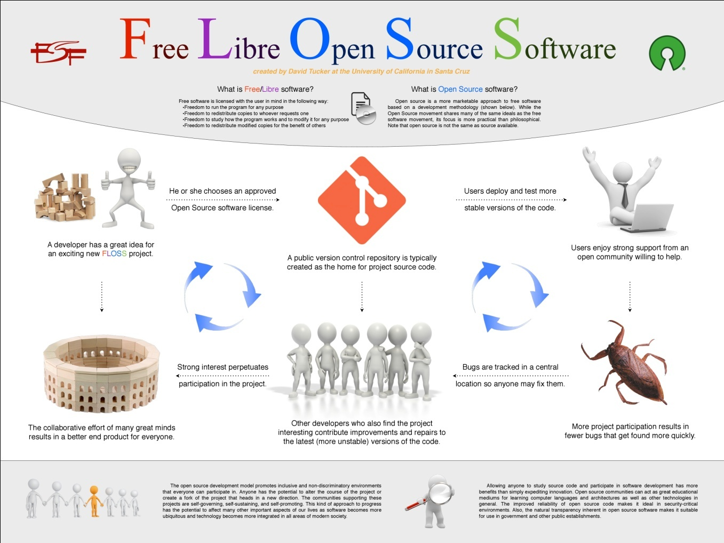
https://visual.ly/community/infographic/technology/free-libre-open-source-software

Slide 10
Forme de proprietate intelectuală
Drept de autor (COPYRIGHT):
Copyright 1992-2014 Free Software Foundation, Inc.
  protejează forma unei lucrări expresive originale (literare, artistice sau tehnice)
Brevet de invenție (PATENT):
U.S. Patent No. 5,636,220 (issued Mar. 12, 2007).
  protejează soluții sau idei originale
Marcă înregistrată (TRADEMARK):
The Python logo is trademarked, and in certain cases permission is required to use it.
  protejează modul de identificare a unui producător sau a altei surse de reputație

Slide 11
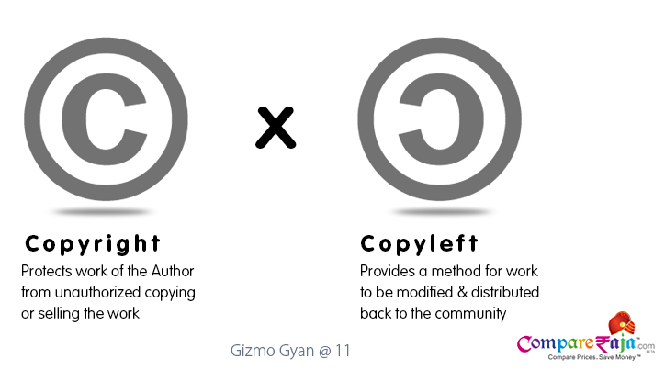
Copyright & Copyleft
Copyright
Format:
Copyright (c) <an> <copyright holder> All rights reserved.
Exemplu:
-------------------------------------------------------------------------------------
* Copyright 2005-present OpenLayers Contributors.
* All rights reserved.
-------------------------------------------------------------------------------------
Copyleft
Oferă dreptul de a distribui liber copii și versiuni modificate cu precizarea că aceleși drepturi și restricții vor fi păstrate și în versiunile modificate.
Este caracteristic licențelor restrictive.
În cadrul pachetelor software se pune problema compatibilității licențelor.
https://angeinitc.wordpress.com/

Slide 12
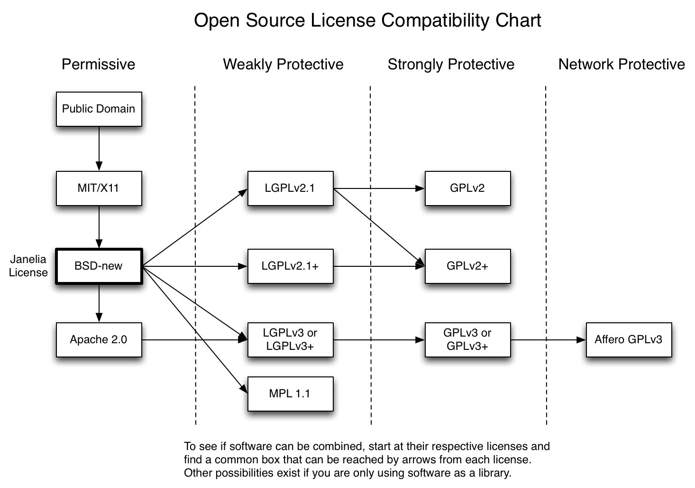
http://janelia-flyem.github.io/licenses.html

Slide 13
3. Licențe
Structura
clasificare
Cele mai utilizate licente foss

Slide 14
Prevederile unei licențe
Exemplu – Apache License
DREPTURI
RESTRICȚII
Redistribuirea oricărei porțiuni de software licențiat sub Apache fără recunoașterea corespunzătoare;
OBLIGAȚII
Includerea unei copii a textului de licență în fiecare copie sau lucrare derivată care include un software sub Apache;
Menționarea clară a contribuției The Apache Software Foundation în lucrările în cadrul cărora este utilizat software-ul sub Apache-.
LIBERTĂȚI
IMPLICITE
De a nu include codul sursă al software-ului Apache sau al modificărilor realizare de utilizator.
De a trimite modificările realizate asupra codului către Apache Software Foundation (deși această acțiune este încurajată).
Descărcarea și utilizarea gratuită a software-ul licențiat sub Apache License, integral sau parțial, în scopuri personale, interne sau comerciale;
Utilizarea software-ul licențiat sub Apache License în pachete create de utilizator.
Utilizarea oricărei mărci deținute de Apache Software Foundation în orice mod care ar putea sugera faptul că Fundația susține/promovează contribuția utilizatorului.
http://www.apache.org/foundation/license-faq.html

Slide 15
Exemplu – Permission Notice
This copyright notice must be distributed on all copies, but this document otherwise may be distributed as part of the Python distribution. No fee may be charged for this document in any representation, either on paper or electronically. This restriction does not affect other elements in a distributed package in any way.

Slide 16
Situații problematice
1. a. Obligații neclare - THE JSON LICENSE
Copyright (c) 2002 JSON.org
Permission is hereby granted, free of charge, to any person obtaining a copy of this software and associated documentation files (the "Software"), to deal in the Software without restriction, including without limitation the rights to use, copy, modify, merge, publish, distribute, sublicense, and/or sell copies of the Software, and to permit persons to whom the Software is furnished to do so, subject to the following conditions:
The above copyright notice and this permission notice shall be included in all copies or substantial portions of the Software.
The Software shall be used for Good, not Evil.
THE SOFTWARE IS PROVIDED "AS IS", WITHOUT WARRANTY OF ANY KIND, EXPRESS OR IMPLIED, INCLUDING BUT NOT LIMITED TO THE WARRANTIES OF MERCHANTABILITY, FITNESS FOR A PARTICULAR PURPOSE AND NONINFRINGEMENT. IN NO EVENT SHALL THE AUTHORS OR COPYRIGHT HOLDERS BE LIABLE FOR ANY CLAIM, DAMAGES OR OTHER LIABILITY, WHETHER IN AN ACTION OF CONTRACT, TORT OR OTHERWISE, ARISING FROM, OUT OF OR IN CONNECTION WITH THE SOFTWARE OR THE USE OR OTHER DEALINGS IN THE SOFTWARE.
1. Licențe neclare
2. Prevederi comerciale
3. Incompatibilitate

Slide 17
# Redistribution and use is allowed according to the terms of the BSD license.
# For details see the accompanying COPYING-CMAKE-SCRIPTS file.
-> http://opensource.apple.com/source/pcre/pcre-7/pcre/cmake/COPYING-CMAKE-SCRIPTS
Redistribution and use in source and binary forms, with or without
modification, are permitted provided that the following conditions
are met:
1. Redistributions of source code must retain the copyright
notice, this list of conditions and the following disclaimer.
2. Redistributions in binary form must reproduce the copyright
notice, this list of conditions and the following disclaimer in the
documentation and/or other materials provided with the distribution.
3. The name of the author may not be used to endorse or promote products
derived from this software without specific prior written permission.
THIS SOFTWARE IS PROVIDED BY THE AUTHOR ``AS IS'' AND ANY EXPRESS OR
IMPLIED WARRANTIES, INCLUDING, BUT NOT LIMITED TO, THE IMPLIED WARRANTIES
OF MERCHANTABILITY AND FITNESS FOR A PARTICULAR PURPOSE ARE DISCLAIMED.
IN NO EVENT SHALL THE AUTHOR BE LIABLE FOR ANY DIRECT, INDIRECT,
INCIDENTAL, SPECIAL, EXEMPLARY, OR CONSEQUENTIAL DAMAGES (INCLUDING, BUT
NOT LIMITED TO, PROCUREMENT OF SUBSTITUTE GOODS OR SERVICES; LOSS OF USE,
DATA, OR PROFITS; OR BUSINESS INTERRUPTION) HOWEVER CAUSED AND ON ANY
THEORY OF LIABILITY, WHETHER IN CONTRACT, STRICT LIABILITY, OR TORT
(INCLUDING NEGLIGENCE OR OTHERWISE) ARISING IN ANY WAY OUT OF THE USE OF
THIS SOFTWARE, EVEN IF ADVISED OF THE POSSIBILITY OF SUCH DAMAGE.
1. b. Versiunea licenței nu este precizată

Slide 18
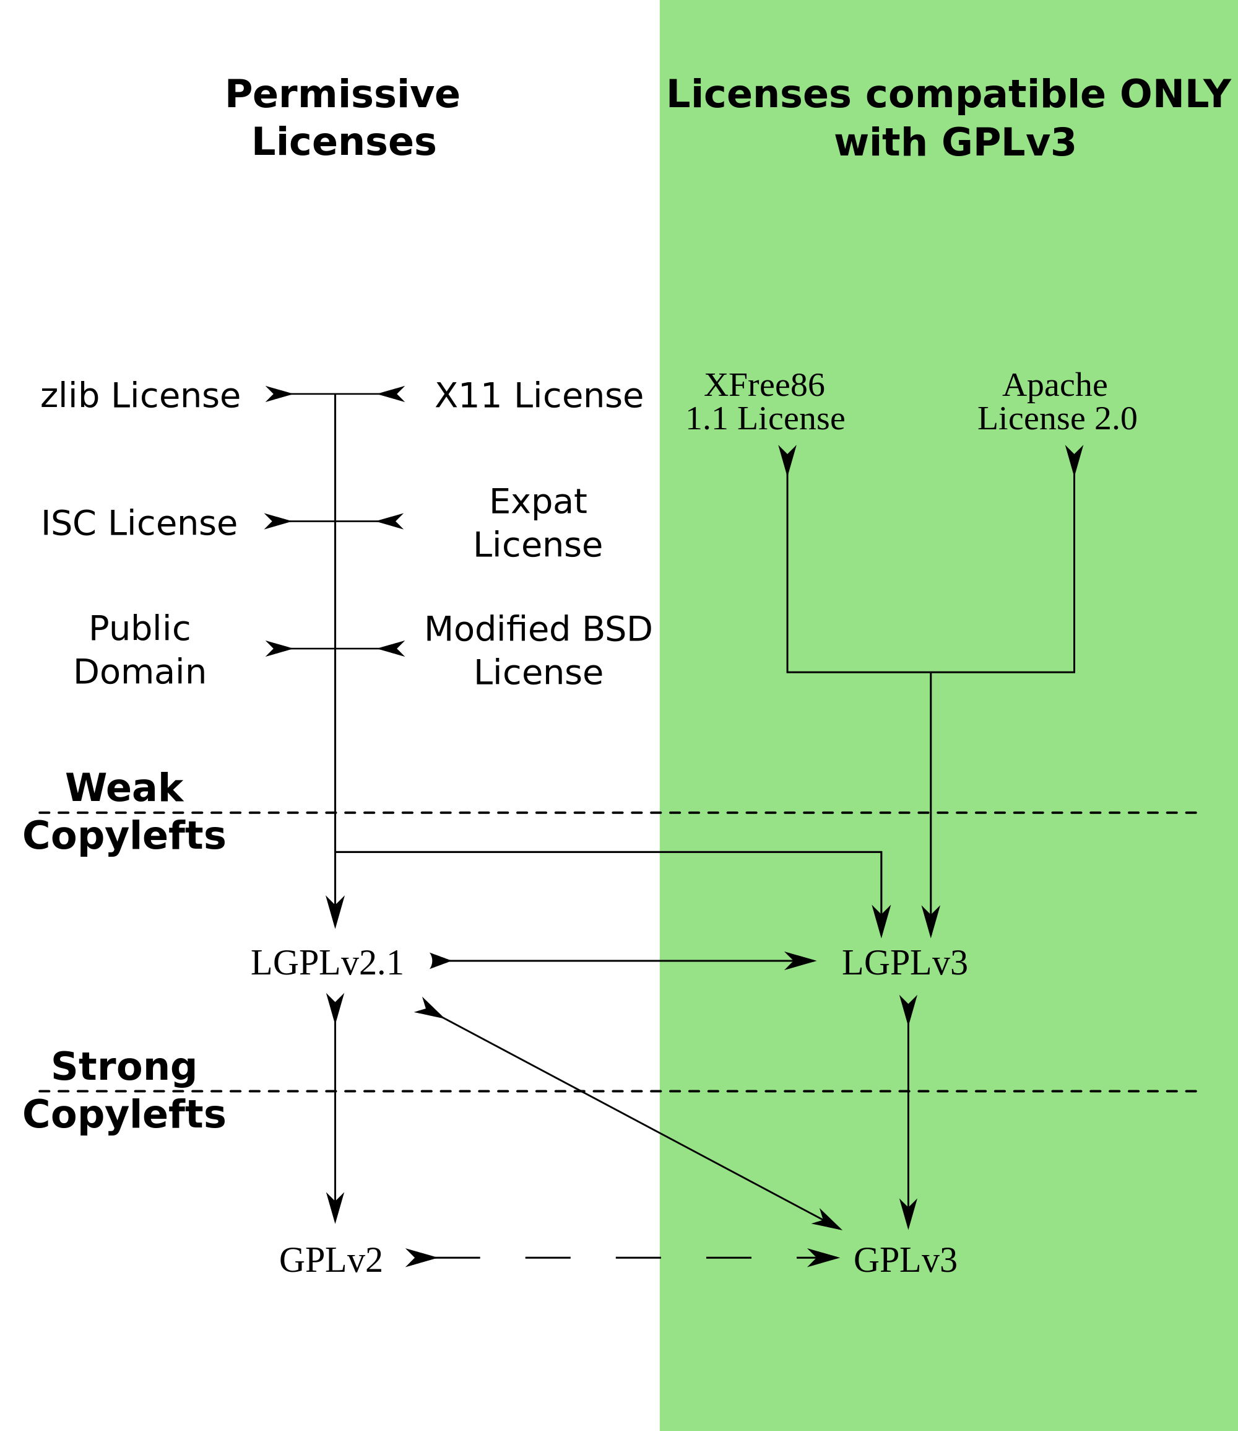
https://commons.wikimedia.org/wiki/File:Quick-guide-gplv3-compatibility.svg
3. Situații de incompatibilitate

Slide 19
Categorii de licențe
Obligații
Cod sursă
Restrictivitate copyleft effect
Restrictive
Permisive
Text - GFDL
Mai puțin restrictive (copyleft limitat)
Scop
Free
Open Source
Comerciale
Font - OFL
Baze de date - ODbL
Hardware - OHL
Complexitate
Simplă
Duală, Triplă
Multiplă
Altă licență
Globală
Aplicabilitate
Alte criterii
Neclară
Excepții -Autoconf, Libtool

Slide 20
* jQuery JavaScript Library v1.7.1
* http://jquery.com/
*
* Copyright 2011, John Resig
* Dual licensed under the MIT or GPL Version 2 licenses.
* http://jquery.org/license
*
* Includes Sizzle.js
* http://sizzlejs.com/
* Copyright 2011, The Dojo Foundation
* Released under the MIT, BSD, and GPL Licenses.
Licență multiplă
- utilizare în pachet comercial
MIT License
GPL-2.0
MIT License
BSD-3-Clause
GPL-2.0
MIT License
sau
și
MIT License/ BSD-3-Clause
sau
sau

Slide 21
* jQuery JavaScript Library v1.7.1
* http://jquery.com/
*
* Copyright 2011, John Resig
* Dual licensed under the MIT or GPL Version 2 licenses.
* http://jquery.org/license
*
* Includes Sizzle.js
* http://sizzlejs.com/
* Copyright 2011, The Dojo Foundation
* Released under the MIT, BSD, and GPL Licenses.
Licență multiplă - utilizare în pachet open-source (exclusiv)
MIT License
GPL-2.0
MIT License
BSD-3-Clause
GPL-2.0
GPL-2.0
sau
și
GPL-2.0
sau
sau

Slide 22
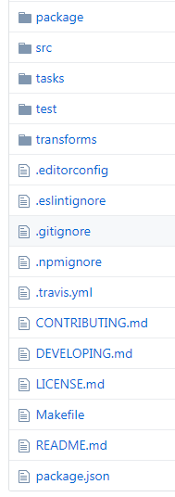
Tipuri de licențe:
Licența globală
Alte licențe
Surse:
Format:
Full-text
Referință
Cod SPDX
Site-ul oficial
Codul sursă
(comentarii)
Fișierele de licență din root:
LICENSE
COPYRIGHT
README
https://github.com/openlayers/openlayers

Slide 23
Full-text:
---------------------------------------------------------------------------------
Copyright (c) <year> <owner> . All rights reserved.
Redistribution and use in source and binary forms, with or without modification, are permitted provided that the following conditions are met:
1. Redistributions of source code must retain the above copyright notice, this list of conditions and the following disclaimer.
2. Redistributions in binary form must reproduce the above copyright notice, this list of conditions and the following disclaimer in the documentation and/or other materials provided with the distribution.
3. All advertising materials mentioning features or use of this software must display the following acknowledgement:
„This product includes software developed by the organization.”
4. Neither the name of the copyright holder nor the names of its contributors may be used to endorse or promote products derived from this software without specific prior written permission.
THIS SOFTWARE IS PROVIDED BY COPYRIGHT HOLDER "AS IS" AND ANY EXPRESS OR IMPLIED WARRANTIES, INCLUDING, BUT NOT LIMITED TO, THE IMPLIED WARRANTIES OF MERCHANTABILITY AND FITNESS FOR A PARTICULAR PURPOSE ARE DISCLAIMED. IN NO EVENT SHALL COPYRIGHT HOLDER BE LIABLE FOR ANY DIRECT, INDIRECT, INCIDENTAL, SPECIAL, EXEMPLARY, OR CONSEQUENTIAL DAMAGES (INCLUDING, BUT NOT LIMITED TO, PROCUREMENT OF SUBSTITUTE GOODS OR SERVICES; LOSS OF USE, DATA, OR PROFITS; OR BUSINESS INTERRUPTION) HOWEVER CAUSED AND ON ANY THEORY OF LIABILITY, WHETHER IN CONTRACT, STRICT LIABILITY, OR TORT (INCLUDING NEGLIGENCE OR OTHERWISE) ARISING IN ANY WAY OUT OF THE USE OF THIS SOFTWARE, EVEN IF ADVISED OF THE POSSIBILITY OF SUCH DAMAGE.
---------------------------------------------------------------------------------

Slide 24
Referințe:
---------------------------------------------------------------------------------
// Use of this source code is governed by a BSD-style license that can be
// found in the LICENSE file.
---------------------------------------------------------------------------------
GeoTools - The Open Source Java GIS Toolkit
http://geotools.org
(C) 2002-2011, Open Source Geospatial Foundation (OSGeo)
This library is free software; you can redistribute it and/or modify it under
the terms of the GNU Lesser General Public License as published by the Free
Software Foundation; version 2.1 of the License.
This library is distributed in the hope that it will be useful, but WITHOUT
ANY WARRANTY; without even the implied warranty of MERCHANTABILITY or FITNESS
FOR A PARTICULAR PURPOSE. See the GNU Lesser General Public License for more details.
---------------------------------------------------------------------------------
---------------------------------------------------------------------------------
SPDX (Software Package Data Exchange):
---------------------------------------------------------------------------------
:license: Apache-2.0, see LICENSE for more details.
---------------------------------------------------------------------------------
* Released under the MIT, BSD-3-Clause, and GPL-2.0 Licenses.
---------------------------------------------------------------------------------

Slide 25
Licențe Blender
The Software
Blender is released under the GNU General Public License (GPL, or “free software”).
This license grants people a number of freedoms:
You are free to use Blender, for any purpose
You are free to distribute Blender
You can study how Blender works and change it
You can distribute changed versions of Blender
The GPL strictly aims at protecting these freedoms, requiring everyone to share their modifications when they also share the software in public. That aspect is commonly referred to as Copyleft.
The Blender Foundation and its projects on blender.org are committed to preserving Blender as free software.
License details
The source code we develop at blender.org is default being licensed as GNU GPL Version 2 or later. Some modules we make are using more permissive licenses, though, for example, the Blender Cycles rendering engine is available as Apache 2.0.
Blender also uses many modules or libraries from other projects. For example, Python uses the Python License; Bullet uses the Zlib License; Libmv uses the MIT License; and OSL, a BSD License.
All the components that together make Blender are compatible under the newer GNU GPL Version 3. That is also the license to use for any distribution of Blender binaries.
Sursă: (site oficial) https://www.blender.org/about/license/

Slide 26
DB Manager * Copyright (c) 2011 Giuseppe Sucameli
Licensed under the terms of GNU GPL v2 (or any layer)http://www.gnu.org/copyleft/gpl.html
Code:
- some code is derived from PG_Manager by Martin Dobias (GPLv2 license)
Icons:
- toolbar icons are derived from gis-0.1 iconset by Robert Szczepanek (Creative Commons Attribution-Share Alike 3.0 Unported license)
- refresh toolbar icon is from Tango project (public domain)
- table, view and namespace icons in database view are from pgAdmin3 (BSD license)
- other icons are from QGIS project (GPLv2 license)
- plugin icon by Sandro Santilli, using qgis icon and database icon by Dracos
- http://commons.wikimedia.org/wiki/File:Applications
- database.svg (Creative Commons Attribution-Share Alike 3.0 Unported license)
Sursă: (în folderul subcomponentei) QGIS-master\python\plugins\db_manager\LICENSE

Slide 27
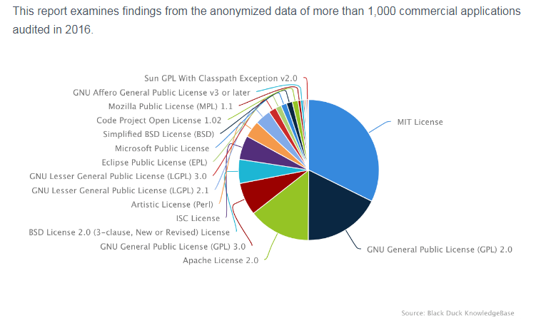
Frecvența de utilizare a licențelor Open source conform BlackDuck
https://www.blackducksoftware.com/top-open-source-licenses

Slide 28
MIT License
1988
Massachusetts Institute of Technology
SPDX: MIT
Copyright <YEAR> <COPYRIGHT HOLDER>
Permission is hereby granted, free of charge, to any person obtaining a copy of this software and associated documentation files (the "Software"), to deal in the Software without restriction, including without limitation the rights to use, copy, modify, merge, publish, distribute, sublicense, and/or sell copies of the Software, and to permit persons to whom the Software is furnished to do so, subject to the following conditions:
The above copyright notice and this permission notice shall be included in all copies or substantial portions of the Software.
THE SOFTWARE IS PROVIDED "AS IS", WITHOUT WARRANTY OF ANY KIND, EXPRESS OR IMPLIED, INCLUDING BUT NOT LIMITED TO THE WARRANTIES OF MERCHANTABILITY, FITNESS FOR A PARTICULAR PURPOSE AND NONINFRINGEMENT. IN NO EVENT SHALL THE AUTHORS OR COPYRIGHT HOLDERS BE LIABLE FOR ANY CLAIM, DAMAGES OR OTHER LIABILITY, WHETHER IN AN ACTION OF CONTRACT, TORT OR OTHERWISE, ARISING FROM, OUT OF OR IN CONNECTION WITH THE SOFTWARE OR THE USE OR OTHER DEALINGS IN THE SOFTWARE.

Slide 29
BSD
(Berkley Software Distribution)
Versiuni:
BSD-4-Clause
BSD-3-Clause
BSD-2-Clause
1988
Regents of the University of California
Copyright (c) <year> <owner> All rights reserved.
Redistribution and use in source and binary forms, with or without modification, are permitted provided that the following conditions are met:
1. Redistributions of source code must retain the above copyright notice, this list of conditions and the following disclaimer.
2. Redistributions in binary form must reproduce the above copyright notice, this list of conditions and the following disclaimer in the documentation and/or other materials provided with the distribution.
3. All advertising materials mentioning features or use of this software must display the following acknowledgement:
„This product includes software developed by the organization”.
4. Neither the name of the copyright holder nor the names of its contributors may be used to endorse or promote products derived from this software without specific prior written permission.
THIS SOFTWARE IS PROVIDED BY COPYRIGHT HOLDER "AS IS" AND ANY EXPRESS OR IMPLIED WARRANTIES, INCLUDING, BUT NOT LIMITED TO, THE IMPLIED WARRANTIES OF MERCHANTABILITY AND FITNESS FOR A PARTICULAR PURPOSE ARE DISCLAIMED. IN NO EVENT SHALL COPYRIGHT HOLDER BE LIABLE FOR ANY DIRECT, INDIRECT, INCIDENTAL, SPECIAL, EXEMPLARY, OR CONSEQUENTIAL DAMAGES (INCLUDING, BUT NOT LIMITED TO, PROCUREMENT OF SUBSTITUTE GOODS OR SERVICES; LOSS OF USE, DATA, OR PROFITS; OR BUSINESS INTERRUPTION) HOWEVER CAUSED AND ON ANY THEORY OF LIABILITY, WHETHER IN CONTRACT, STRICT LIABILITY, OR TORT (INCLUDING NEGLIGENCE OR OTHERWISE) ARISING IN ANY WAY OUT OF THE USE OF THIS SOFTWARE, EVEN IF ADVISED OF THE POSSIBILITY OF SUCH DAMAGE.

Slide 30
Apache License
Versiuni:
Apache-1.0
Apache-1.1
Apache-2.0
The Apache Software Foundation
SPDX: Apache-2.0

Slide 31
Apache Software License
Version 1.1
Copyright (c) 2000 The Apache Software Foundation. All rights reserved.
Redistribution and use in source and binary forms, with or without modification, are permitted provided that the following conditions are met:
1. Redistributions of source code must retain the above copyright notice, this list of conditions and the following disclaimer.
2. Redistributions in binary form must reproduce the above copyright notice, this list of conditions and the following disclaimer in the documentation and/or other materials provided with the distribution.
3. The end-user documentation included with the redistribution, if any, must include the following acknowledgment:
"This product includes software developed by the Apache Software Foundation (http://www.apache.org/)."
Alternately, this acknowledgment may appear in the software itself, if and wherever such third-party acknowledgments normally appear.
4. The names "Apache" and "Apache Software Foundation" must not be used to endorse or promote products derived from this software without prior written permission. For written permission, please contact apache@apache.org.
5. Products derived from this software may not be called "Apache", nor may "Apache" appear in their name, without prior written permission of the Apache Software Foundation.
THIS SOFTWARE IS PROVIDED "AS IS" AND ANY EXPRESSED OR IMPLIED WARRANTIES, INCLUDING, BUT NOT LIMITED TO, THE IMPLIED WARRANTIES OF MERCHANTABILITY AND FITNESS FOR A PARTICULAR PURPOSE ARE DISCLAIMED. IN NO EVENT SHALL THE APACHE SOFTWARE FOUNDATION OR ITS CONTRIBUTORS BE LIABLE FOR ANY DIRECT, INDIRECT, INCIDENTAL, SPECIAL, EXEMPLARY, OR CONSEQUENTIAL DAMAGES (INCLUDING, BUT NOT LIMITED TO, PROCUREMENT OF SUBSTITUTE GOODS OR SERVICES; LOSS OF USE, DATA, OR PROFITS; OR BUSINESS INTERRUPTION) HOWEVER CAUSED AND ON ANY THEORY OF LIABILITY, WHETHER IN CONTRACT, STRICT LIABILITY, OR TORT (INCLUDING NEGLIGENCE OR OTHERWISE) ARISING IN ANY WAY OUT OF THE USE OF THIS SOFTWARE, EVEN IF ADVISED OF THE POSSIBILITY OF SUCH DAMAGE.
This software consists of voluntary contributions made by many individuals on behalf of the Apache Software Foundation. For more information on the Apache Software Foundation, please see <http://www.apache.org/>.
Portions of this software are based upon public domain software originally written at the National Center for Supercomputing Applications, University of Illinois, Urbana-Champaign.

Slide 32
=========================================================================
== Example NOTICE file for use with the Apache License, Version 2.0, ==
== in this case for the Apache httpd-2.5.0 distribution. == =========================================================================
Apache HTTP Server
Copyright 2016 The Apache Software Foundation.
This product includes software developed at
The Apache Software Foundation (http://www.apache.org/).
Portions of this software were developed at the National Center
for Supercomputing Applications (NCSA) at the University of
Illinois at Urbana-Champaign.
This software contains code derived from the RSA Data Security
Inc. MD5 Message-Digest Algorithm, including various
modifications by Spyglass Inc., Carnegie Mellon University, and
Bell Communications Research, Inc (Bellcore).
Copyright [yyyy] [name of copyright owner]
Licensed under the Apache License, Version 2.0 (the "License");
you may not use this file except in compliance with the License.
You may obtain a copy of the License at
http://www.apache.org/licenses/LICENSE-2.0
Unless required by applicable law or agreed to in writing, software
distributed under the License is distributed on an "AS IS" BASIS,
WITHOUT WARRANTIES OR CONDITIONS OF ANY KIND, either express or implied.
See the License for the specific language governing permissions and
limitations under the License.

Slide 33
Permission Notice
# Derived from code bearing the following notice:
#
# The author of this software is Steven Fortune. Copyright (c) 1994 by AT&T
# Bell Laboratories. Autor & copyright notice
# Permission to use, copy, modify, and distribute this software for any
# purpose without fee is hereby granted, provided that this entire notice
# is included in all copies of any software which is or includes a copy
# or modification of this software and in all copies of the supporting
# documentation for such software. Libertăți & obligații
# THIS SOFTWARE IS BEING PROVIDED "AS IS", WITHOUT ANY EXPRESS OR IMPLIED
# WARRANTY. IN PARTICULAR, NEITHER THE AUTHORS NOR AT&T MAKE ANY
# REPRESENTATION OR WARRANTY OF ANY KIND CONCERNING THE MERCHANTABILITY
# OF THIS SOFTWARE OR ITS FITNESS FOR ANY PARTICULAR PURPOSE. Disclaimer
#
# Comments were incorporated from Shane O'Sullivan's translation of the
# original code into C++ (http://mapviewer.skynet.ie/voronoi.html)
#
# Steve Fortune's homepage: http://netlib.bell-labs.com/cm/cs/who/sjf/index.html

Slide 34

Public Domain
# This program is in the public domain.
-------------------------------------------------------------
* This DTD describes the maplayers and their symbology and
* is used when saving/restoring a QGIS project.
* This file is in the public domain.
-------------------------------------------------------------
https://sourceforge.net/p/mingw/mingw-org-wsl/ci/legacy/tree/mingwrt/mingwex/gettimeofday.c#l31
* THIS SOFTWARE IS NOT COPYRIGHTED
*
* This source code is offered for use in the public domain. You may
* use, modify or distribute it freely.
*
* This code is distributed in the hope that it will be useful but
* WITHOUT ANY WARRANTY. ALL WARRANTIES, EXPRESS OR IMPLIED ARE HEREBY
* DISCLAIMED. This includes but is not limited to warranties of
* MERCHANTABILITY or FITNESS FOR A PARTICULAR PURPOSE.
*
* Contributed by:
* Danny Smith <dannysmith@users.sourceforge.net>
Codul este disponibil publicului
Nu se află sub influența unui copyright sau dreptul de copyright a expirat
The Public Domain Mark,
dezvoltat de Creative Commons.

Slide 35
4. Perspective
Pași de scanare și nivele de analiză
Interacțiunea dintre licențe
Licențe ale instrumentelor gis

Slide 36
Perspective
Dezvoltator FOSS
Sunt FOSS secvențele de cod pe care vreau sa le integrez/modific?
Dezvoltator software comercial
Pot fi utilizare într-un software comercial porțiunile de cod FOSS de care am nevoie?
FOSS Compliance Analyst
Ce nevoi are clientul meu?
Sunt compatibile licențele produsului final?
Ce licență aleg pentru codul modificat?
Utilizator FOSS
Este FOSS tool-ul pe care vreau sa îl folosesc?
Am alte licențe comerciale sau neclare de care trebuie sa mă ocup?
Ce tool-uri de scanare aleg să folosesc?
Ce pași aleg să urmez?
Aș putea să îl îmbunătățesc?

Slide 37
Nivele de analiză
1. Stabilirea licenței globale
  Căutare pe site-ul oficial și în root-ul pachetului
  Verificarea versiunii pachetului
  Verificare modificări, relicențieri (Changelog, forumuri)
2. Căutare în pachet după cuvinte-cheie
  copyright,
  license, etc
3. Scanare utilizând un tool după cuvinte-cheie
  Fossology, Palamida, etc
4. Scanare utilizând un tool după cuvinte-cheie
  Blackduck, etc

Slide 38





Tool-uri de scanare
Cuvinte-cheie
  Licențe și referințe de licențe free și open source
  Referințe de licențe comerciale
  Copyright
  Autori
  Vulnerabilități în ceea ce privește securitatea
  Restricții de export
  Patente
  Cod criptat
Cod sursă
https://www.capterra.com/license-management-software/

Slide 39
Licențe globale ale principalelor instrumente GIS
GIS Desktop |  | Dezvoltarea aplicațiilor GIS
QGIS | GPL-2.0+ | OpenLayers | BSD-2-Clause
GRASS GIS | GPL-2.0+ | Leafletjs | BSD-2-Clause
SAGA GIS | GPL-2.0/LGPL-2.0 | GeoTools | LGPL-2.1
TileMill | BSD-3-Clause Mapbox | GDAL/OGR | MIT License
VTP | MIT License | Servere GIS
ILWIS | GPL-3.0 | GeoServer | GPL-2.0 with Exception
Blender | GPL-2.0+ | Mapnik | LGPL-2.1
uDig | Duală: EPL-1.0 / EDL-1.0 | MapServer | MIT License
Gestionare a bazelor de date spațiale |  | Comerciale
PostgreSQL | PostgreSQL License (MIT style) | GlobalMapper
PostGIS | GPL-2.0+ | ArcMap (ArcGIS)
SpatiaLite | Triplă: MPL-1.1 / GPL-2.0+ / LGPL-2.1+ | ENVI
SQLite | Public Domain | Surfer

Slide 40
Alte licențe...
DO WHAT THE FUCK YOU WANT TO PUBLIC LICENSE
Version 2, December 2004
Copyright (C) 2004 Sam Hocevar <sam@hocevar.net>
Everyone is permitted to copy and distribute verbatim or modified copies of this license document, and changing it is allowed as long as the name is changed.
DO WHAT THE FUCK YOU WANT TO PUBLIC LICENSE TERMS AND CONDITIONS FOR COPYING, DISTRIBUTION AND MODIFICATION
0. You just DO WHAT THE FUCK YOU WANT TO.
* ----------------------------------------------------------------------------
* "THE BEER-WARE LICENSE" (Revision 42):
* <phk@FreeBSD.ORG> wrote this file. As long as you retain this notice you
* can do whatever you want with this stuff. If we meet some day, and you think
* this stuff is worth it, you can buy me a beer in return Poul-Henning Kamp
* ----------------------------------------------------------------------------
** The author disclaims copyright to this source code. In place of
** a legal notice, here is a blessing:
**
** May you do good and not evil.
** May you find forgiveness for yourself and forgive others.
** May you share freely, never taking more than you give.

Slide 41
FSF
OSI
Open Source
Licență
Copyright
Copyleft
Obligații
Libertăți
Licență globală
Incompatibilitate
Licență duală
Fossolgy
BlackDuck
Palamida
GPL
Apache
BSD
Proprietate intelectuală
Licență permisivă
SPDX
Public Domain
Referință de licență

Slide 42
Link-uri utile
Definiția Open Source conform OSI:
https://opensource.org/docs/osd
Comparație licențe FOSS:
https://en.wikipedia.org/wiki/Comparison_of_free_and_open-source_software_licenses
Rezumate licențe:
https://enterprise.dejacode.com/license_library/
https://tldrlegal.com/
Obligații, restricții și libertăți licențe:
https://en.wikibooks.org/wiki/FOSS_Licensing/How_to_Make_the_Source_Free_or_Open
Licențe conform SPDX:
https://spdx.org/licenses/
Compatibilitate cu GPL:
https://www.gnu.org/licenses/license-list.html

Slide 43
Bibliografie selectivă
https://is.muni.cz/th/324820/fi_m/fithesis.pdf
https://ro.wikipedia.org/wiki/Proprietate_intelectual%C4%83
http://www.rosenlaw.com/oslbook.htm
https://www.capterra.com/license-management-software/
https://www.apache.org
http://janelia-flyem.github.io/licenses.html
https://commons.wikimedia.org/wiki/File:Quick-guide-gplv3-compatibility.svg
https://www.blender.org/about/license/
https://github.com/openlayers/openlayers
https://www.blackducksoftware.com/top-open-source-licenses
https://angeinitc.wordpress.com/
https://www.blender.org/about/license/

