Slide 1

Mediu Virtual de Cercetare pentru știinte naturale, climatologie și conservarea patrimoniului cultural
Daniel POP
West University of Timisoara

Slide 2

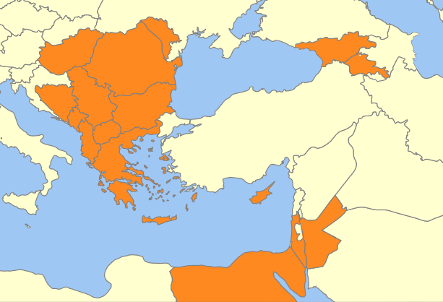
VI-SEEM Members
Map created using http://philarcher.org/diary/2013/euromap/, Attribution-Share Alike 3.0 Unported

Slide 3
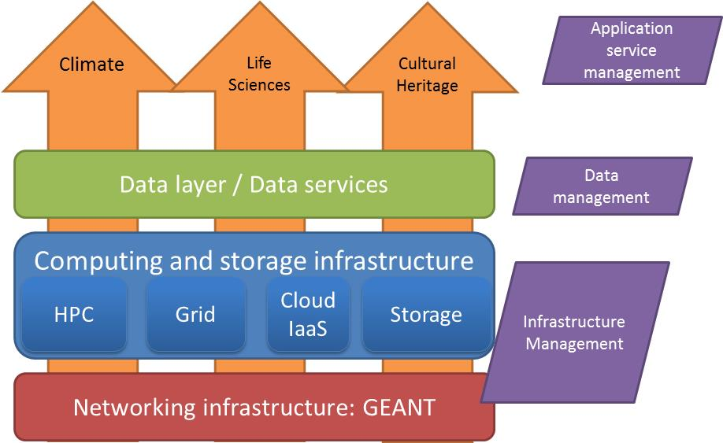
VI-SEEM In a figure

Slide 4
Objectives (1)
Provide scientists with access to state of the art e-Infrastructure - computing, storage and connectivity resources - available in the region; and promote additional resources across the region.
  Infrastructure – 21500 CPU cores, 325000 GP-GPU cores and 18500 Intel Xeon Phi cores of HPC, 2900 grid cores, 10500 cloud VM cores, 11 PBytes of storage
Integrate the underlying e-Infrastructure layers with generic/standardised as well as domain-specific services for the region.
Promote capacity building in the region and foster interdisciplinary approaches
  Goal: minimum of 39 distinct applications and 45 research teams using the VRE

Slide 5
Objectives (2)
Provide functions allowing for data management for the selected Scientific Communities
  minimum of 30 distinct data sets
Provide adequate user support and training programmes
Enable research activities of international standing in the selected fields of Climatology, Life Sciences and Cultural Heritage

Slide 6
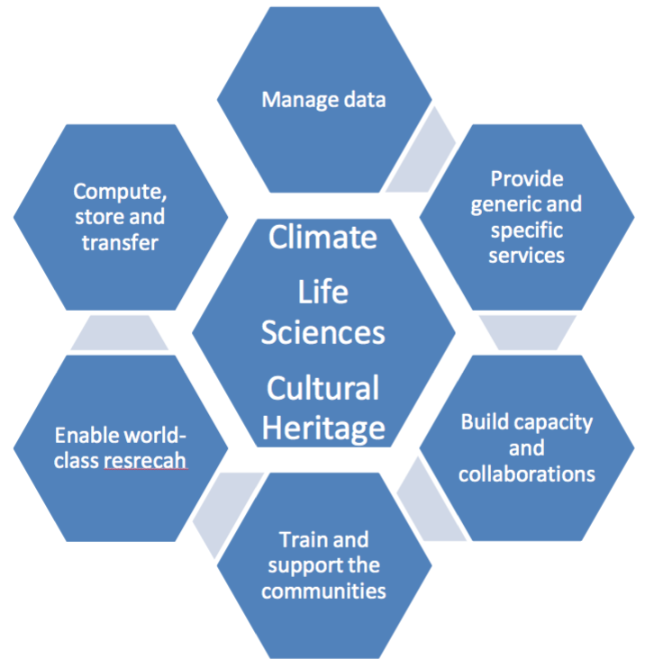
Objectives

Slide 7
Operational Services
Infrastructure
  Provision of HPC, Cloud and Grid resources
Operational services
  VI-SEEM Code repository
    Used to upload source codes produced in the context of the project, or host source code from communities
    https://code.vi-seem.eu/
  VI-SEEM Service Catalogue
    Used to provide information about VI-SEEM Services to end users as well as for managing the service portfolio internally
    https://services.vi-seem.eu/
  VI-SEEM Login
    The AAI infrastructure of the project.
    https://aai.vi-seem.eu
  VI-SEEM Helpdesk:
  https://support.vi-seem.eu

Slide 8
Data Services
VI-SEEM Simple Storage
  Used to store simple files, important for everyday use and collaboration
  STATUS: Available and integrated with VI-SEEM Login
VI-SEEM Repository
  Used as a generic loner term dataset repository
  STATUS: Available and integrated with VI-SEEM Login
VI-SEEM Search
  Used to consolidate all data sets (via metadata harvesting) that are available to VI-SEEM
  STATUS: Available

Slide 9
Data Services
VI-SEEM Archiving
  For safe archiving of large data sets
  STATUS: Work in progress
VI-SEEM Work Storage
  Used to transfer files among HPC centers for processing in HPC apps
  STATUS: Work in progress
Data analytics
  Used to process data using Hadoop
  STATUS: Needs to be added to the service catalogue
PID Service
  Used to generate permanent ID
  STATUS: Available but not integrated yet with the rest of the services

Slide 10
Application Services
VRE Platform (http://vre.vi-seem.eu)
  The main entry point for the user communities of the region and beyond
  STATUS: Available
Scientific Application Environment
  Software modules that are installed and optimized for the use by the communities
  STATUS: In production. To be added to the service catalogue.
Workflow and Software tools
  Used to provide a series of “processes” for scientific simulations
  STATUS: Workflows are available as documents

Slide 11
Application Services
Regional community datasets
  Used to share research data sets
  STATUS: Some exist and they are stored in different services i.e. Clowder, LAS, VI-SEEM repo, or remote community repositories, need to be integrated with VI-SEEM Search service.
Application Level Services
  Application specific services
  STATUS: Clowder (for Cultural Heritage), Live Access Server (for Climate) and ChemBioServer (for Life Sciences) are available. Need to identify new ones and add all of them to the service portfolio

Slide 12
VRE Content for Climate Community
  VRE Portal Up and Running
  Scientific application environment:
    Added Optimized applications and libraries for Climate Community
    List of codes added
  Regional Community Datasets
    Added Regional Climate Simulation Datasets from Cyprus and Bulgaria
    https://vre.vi-seem.eu/index.php/regional-community-datasets/climate-datasets
  Application-Level Services for the regional communities:
    Live Access Server up and running

Slide 13
Live Access Server (LAS)
LAS up and running on local server at CyI: http://las.vi-seem.eu
  LAS enables end-users to visualize data with on-the-fly graphics, request custom subsets of variables in a choice of file formats, access background reference material about the data (metadata), and compare (difference) variables from distributed locations.
Rich Initial content
  Feature datasets from global data repositories
  Include regional data readily available
LAS Implementation workflow added to VRE
LAS tutorial added to Training Portal (https://training.vi-seem.eu/)
Allow remote data hosting & access:
  Aim to allow individual sites to host data
  Individual partners can run interconnected LAS or just serve data through open protocols
  LAS Virtual Machine Image produced to be made available on VRE

Slide 14
LAS features
Highly configurable server designed to provide flexible access to geo-referenced scientific data.
Present distributed data sets as a unified virtual data base through the use of DODS networking.
Ferret is the default visualization application used by LAS, though other applications (Matlab, IDL, GrADS, ...) can also be used.
Can also export to Google Earth (still in beta).

Slide 15
LAS functionality
LAS enables the web user to:
  visualize data with on-the-fly graphics
  request custom subsets of variables in a choice of file formats
  access background reference material about the data (metadata)
  compare (difference) variables from distributed locations
LAS enables the data provider to:
  unify access to multiple types of data in a single interface
  create thematic data servers from distributed data sources
  offer derived products on the fly
  remedy metadata inadequacies (poorly self-describing data)
  offer unique products (e.g. visualization styles specialized for the data)

Slide 16
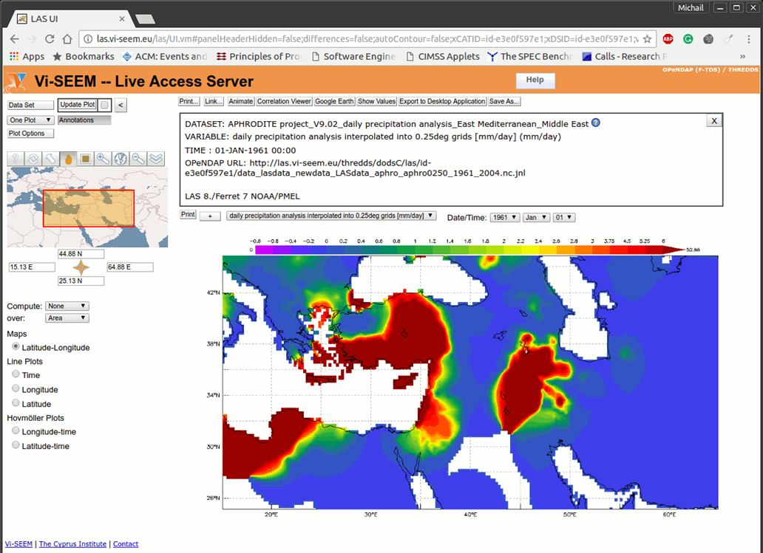
LAS GUI

Slide 17
Romanian applicaitons
  BVL (Banatica Virtual Library), Biblioteca Centrala Universitara “Eugen Todoran”
  1st integration phase
  Banatica collection
  1000+ bibliographical references
  200 digitized books
  Integrated in Clowder platform
  Running OCR – Work in progress for the next 6 months
  HIRECLIMS, Administratia National de Meteorologie
  2nd integration phase
  gridded dataset from observations consisting of 9 essential climate variables with daily values (1961-2013) on a spatial resolution of 10 km for the Romanian territory (ROCADA)
  access to resources has been granted
  need to (re)start

Slide 18
1st Call for Projects
1st call important Dates:
  Opening date: 14th October 2016
  Closing Date: 14th November 2016
  Clarification provided by applicants if needed: 18th November 2016
  Allocation decision: January 2017
  Allocation Start Date of awarded proposals: January 2017
  Allocation end date of award: January 2018 for computational services, January 2019 for some data services.
  Final report from successful projects: May 2017
2nd call will be launched begin of 2017
3rd call will be launched end of 2017

Slide 19
Climate Research Open Call Areas
Open Calls in the scientific field of Climate Research:
  CR Area A: Regional climate modelling to better understand and predict climate change and impacts, and phenomena such as dust storms.
  CR Area B: Air quality modelling, including atmospheric chemistry and air pollution transport.
  CR Area C: Weather forecast and extreme weather prediction, model development, application.

Slide 20
To conclude
Regional Datasets
Storage and computational resources
Live Access Server
Apply for next Open Calls for Projects

